Slide 1

Blood Donation Management System
A Project by Students of BSCS-1OA
Ayesha Tahir, 340499
Haleema Sadia, 332423
Mashal Ashfaque, 337203

Slide 2
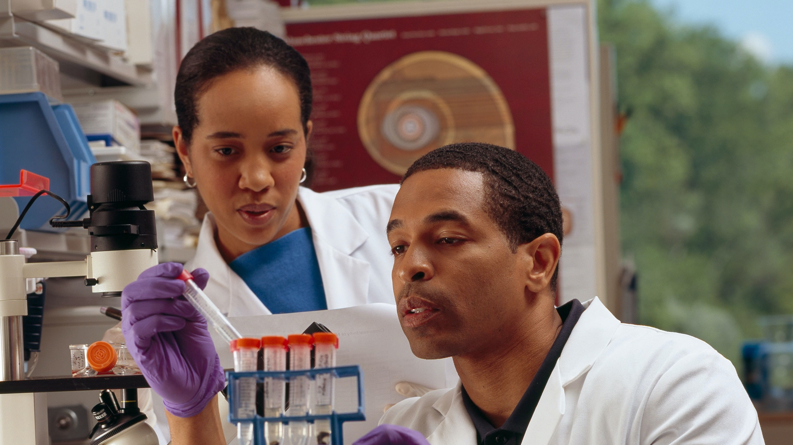



What We Want to Build
A Blood Donation Management System which includes:
A link between hospitals and blood banks
A link between donor/recipient and blood banks
A link between donor/recipient and hospitals

Slide 3

What We Want to Build (Contd…)
An easy way for:
Hospitals to keep track of what blood banks give their stocks to them
Blood banks to keep track of what hospitals they donate to

Slide 4
What We Want to Build (Contd...)
An easy way for:
Keeping a record of the donors/recipients involved in a blood donation and what facility they donate to/receive blood from.
Forensic Tracing in case of anomalies post exchange

Slide 5

What We Want to Build (Contd...)
An easy way for:
Locating the nearest facility for blood donation
Finding Possible Donors

Slide 6




Business Rules/Constraints (Contd…)
A blood exchange has a source and a recipient
A person can be a donor as well as a recipient
In one blood exchange, the person donating the blood cannot be the same as the person receiving.

Slide 7
Business Rules/Constraints (Contd…)
A hospital may handle multiple blood exchanges but one blood exchange takes place at one hospital only (and must belong to a hospital)

Slide 8



Business Rules/Constraints (Contd…)
Each facility (can be blood bank or hospital)/person must provide minimum 1 and maximum three contact numbers.

Slide 9


Business Rules/Constraints (Contd…)
Each facility/person must have an address.
Multiple people/facilities can have the same address.

Slide 10


Business Rules/Constraints (Contd…)
Each facility/person must provide an e-mail address.

Slide 11
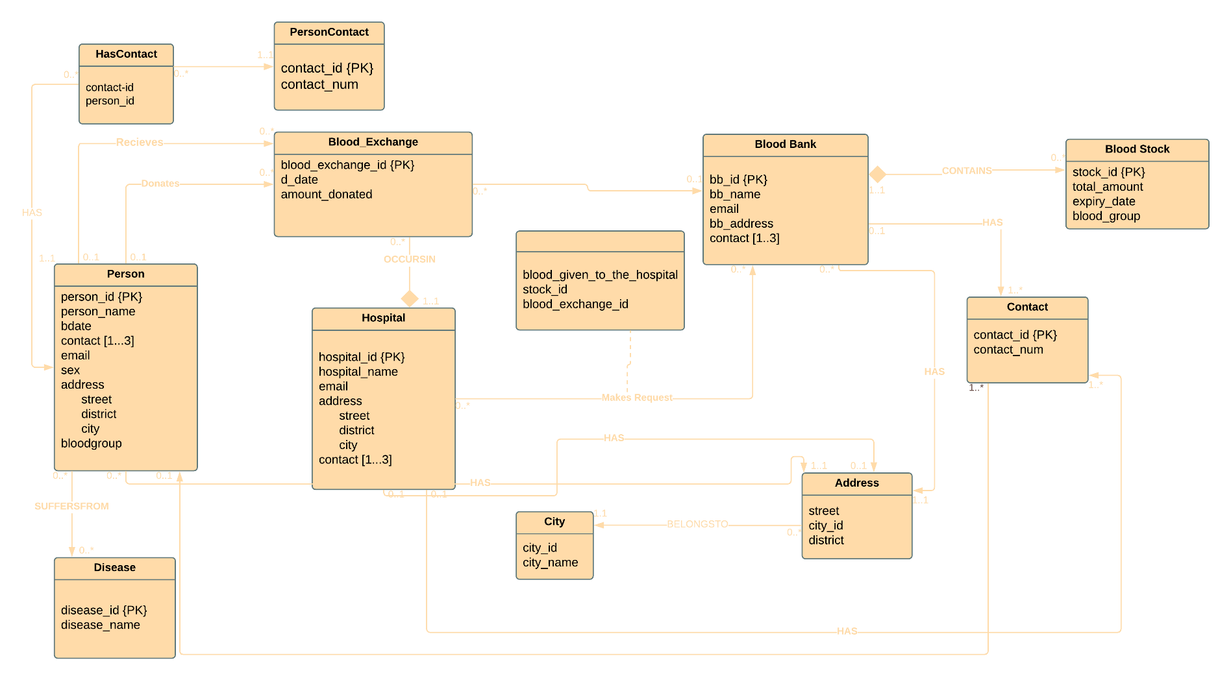
ER Diagram

Slide 12
Demo

